Slide 1
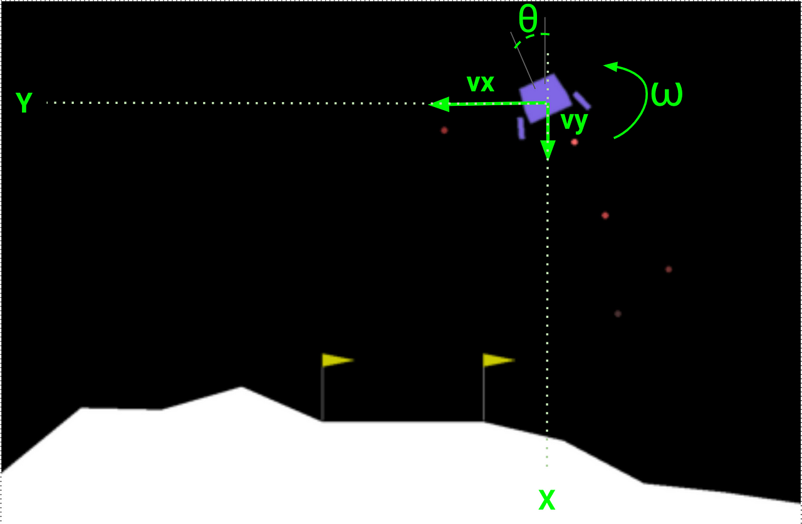
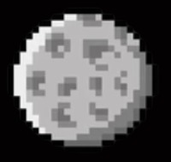
Lunar Lander Agent Using Deep Reinf.rcement Learning
Presenter: Sanchit Bhardwaj (Eno. -> 06790302021)
Deepak Sehrawat (Eno. -> 10490302021)

Slide 2
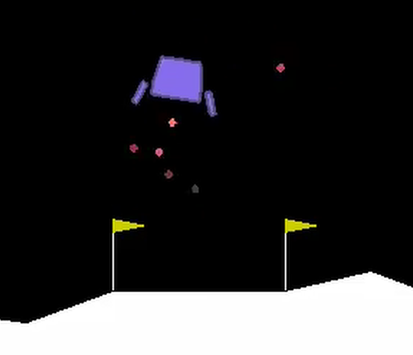
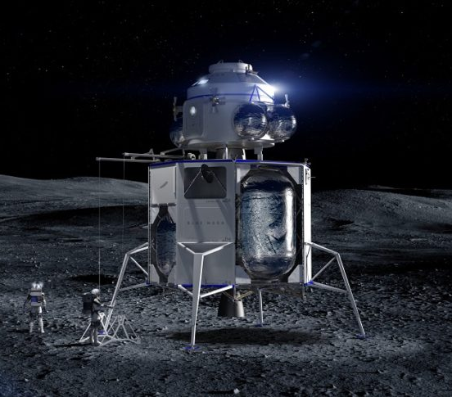
Problem Statement
Problem Statement: Develop an AI agent that can learn to safely and efficiently land a lunar module within a simulated environment, leveraging the principles of Deep Reinforcement Learning.
This statement clearly outlines the core challenge:
"Develop an AI agent": You are creating an autonomous decision-making system.
"Learn to safely and efficiently land": The agent's goals are safety (no crashing!) and efficiency (minimal fuel use).
"Lunar module within a simulated environment": You are working with a specific task (lunar landing) and using a controlled simulation for training.
"Leveraging Deep Reinforcement Learning": You are employing a specific AI approach, implying the use of neural networks and reward-based learning.

Slide 3
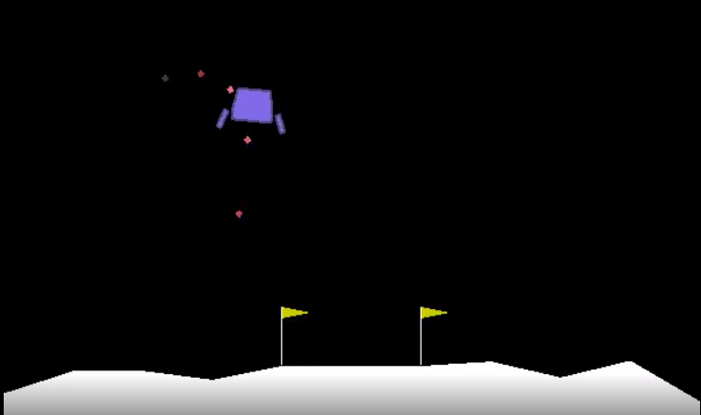
Action Space
4 Discrete Actions:
Fire Left Engine
Fire Right Engine
Fire Main Engine
Do Nothing
Left Engine
Right Engine
-0.03 points each frame
-0.03 points each frame
Main Engine
-0.3 points each frame
Landing Pad (0,0)

Slide 4
Reward
Crash | – 100 points
Come to Rest | + 100 points
Leg Contact | + 10 points
Zero Speed Touchdown | + (100 – 140) points
Solved | + 200 points
Firing Main Engine | – 0.3 points per frame
Firing Side Engine | – 0.03 points per frame
Fuel Supply | Unlimited

Slide 5
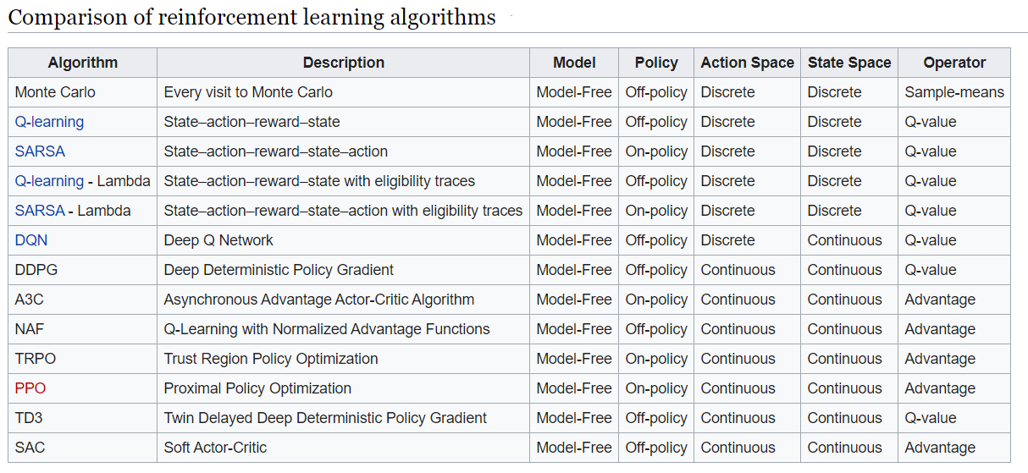
Solution – Algorithm
Information retrieved from https://en.wikipedia.org/wiki/Reinforcement_learning

Slide 6
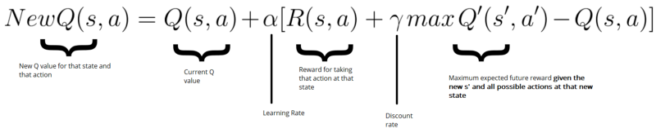

Solution – DQN
DQN
Q-Learning
Deep Neural Network

Slide 7
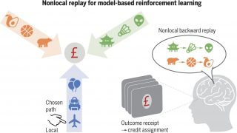
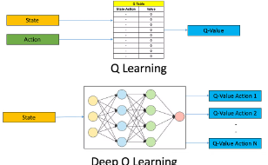
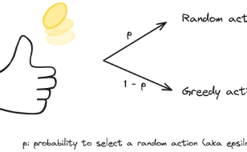
Key Components of DQN
Experience Replay
Epsilon-Greedy Exploration
Target Network
Our DQN agent uses a replay buffer to store past experiences from the LunarLander environment. Each experience includes the state, action, reward, next state, and episode end. During training, we randomly sample batches from the buffer, allowing the agent to learn from diverse experiences and improve data efficiency while preventing overfitting.
To ensure stable learning, we use a target network, a less frequently updated copy of the Q-network. This provides consistent target values for Q-value updates, preventing oscillations and divergence during training.
Our agent uses an epsilon-greedy strategy to balance exploration and exploitation. It selects a random action with probability epsilon to explore and chooses the highest estimated Q-value action with probability (1-epsilon) to exploit. Epsilon decreases over time, shifting focus from exploration to exploitation.

Slide 8
Solution – Network
Hidden Layer
FC # I
RELU
64 nodes
Hidden Layer
FC # II
RELU
64 nodes
State Space (8 nodes)
(Input Layer)
Hidden Layers
Action Space (4 nodes)
(Output Layer)

Slide 9
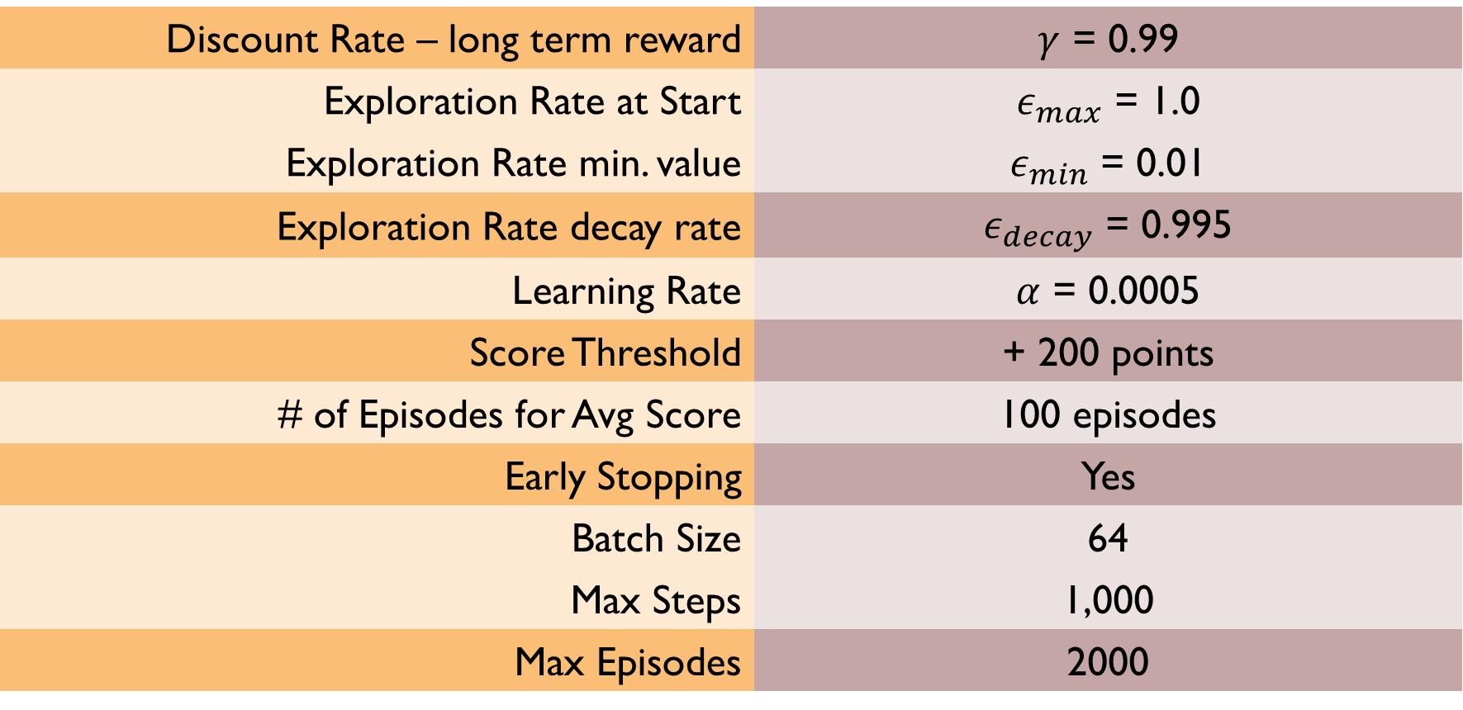
Solution – Parameters
Discount Rate – long term reward | $γ$ = 0.99
Exploration Rate at Start | $ε_{max}$ = 1.0
Exploration Rate min. value | $ε_{min}$ = 0.01
Exploration Rate decay rate | $ε_{decay}$ = 0.995
Learning Rate | $α$ = 0.0005
Score Threshold | + 200 points
# of Episodes for Avg Score | 100 episodes
Early Stopping | Yes
Batch Size | 64
Max Steps | 1,000
Max Episodes | 2000

Slide 10
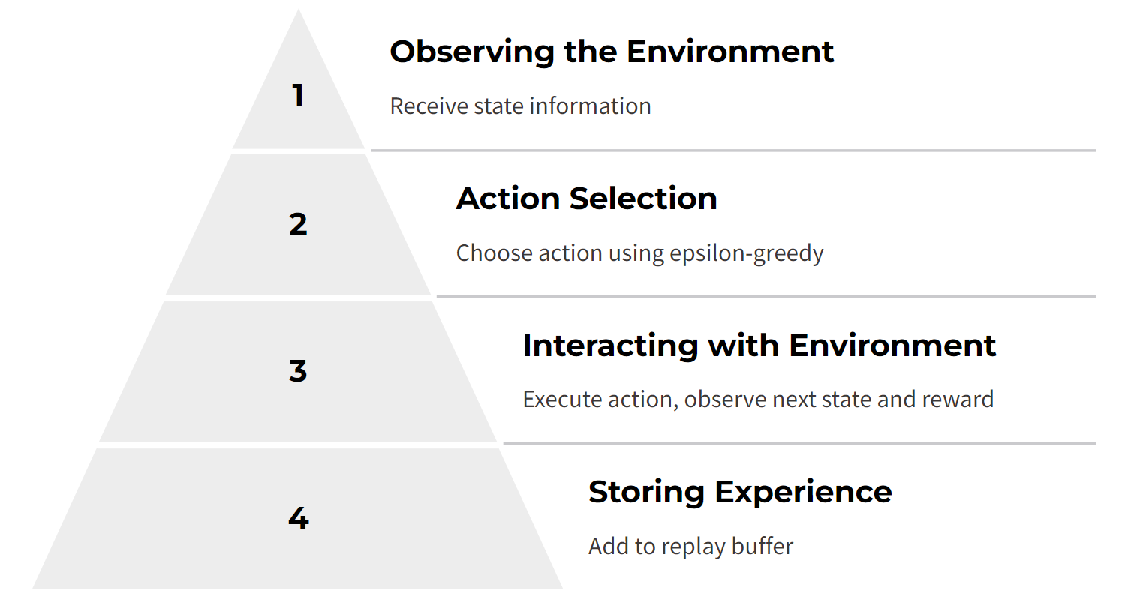
Training Process
The training process is where our DQN agent truly comes to life, learning through experience and gradually mastering the art of lunar landing. This process involves a continuous cycle of interaction with the LunarLander environment, knowledge acquisition, and Q-value updates.

Slide 11
Learning from Experience:
Sampling: A batch of experiences is randomly sampled from the replay buffer. This ensures the agent learns from a diverse set of past events and avoids overfitting to recent experiences.
Q-Value Updates: The Q-network estimates the Q-values for the states and actions in the sampled batch. Meanwhile, the target network estimates the Q-values for the next states. Using the Bellman equation, target Q-values are calculated, representing the expected future rewards.
Loss Calculation and Network Update: The difference between the predicted Q-values and the target Q-values is calculated as the loss. This loss is then used to update the Q-network's parameters through backpropagation, guiding the network towards more accurate Q-value estimations.
Updating the Target Network: The target network's parameters are periodically updated to slowly track the Q-network's parameters. This ensures stability and prevents the learning process from diverging.

Slide 12
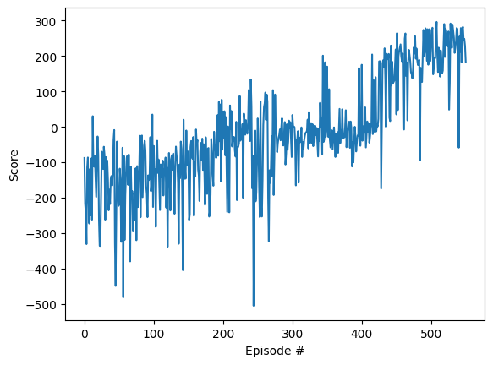
Solution – Outcome

Slide 13
Training
Episode = 10
Episode = 100

Slide 14
Successful Landing [past mentioned threshold (200 points)]
Episode = 451

Slide 15
Key Outcomes
Produced a generalized model that safely lands the lander with good landing principles (approach)
+200.98 points
451 Episodes
Average Score
# of Episodes

Slide 16
Insights and Challenges
Effectiveness of DQN
Challenges Encountered
The project faced several challenges, including difficulties with hyperparameter tuning, training instability, and limitations of the DQN algorithm. Careful experimentation and adjustments were required to overcome these obstacles and achieve the desired performance.
The evaluation metrics indicate that the DQN algorithm was effective in solving the LunarLander task. The DQN approach was able to learn complex control strategies and adapt to the environment's dynamics, demonstrating its strengths in this application.

Slide 17
Future Work and Potential Improvements
1
Exploring Advanced Neural Network Architectures
2
Experimenting with Alternative Exploration Strategies
Implementing DQN
Variants
3
Investigate the use of more sophisticated neural network architectures, such as convolutional neural networks (CNNs) or recurrent neural networks (RNNs), to potentially capture spatial or temporal relationships within the LunarLander environment more effectively.
Explore different exploration strategies beyond epsilon-greedy, such as Boltzmann exploration or Bayesian approaches, to find a better balance between exploration and exploitation during the learning process.
Implement and evaluate advanced DQN variants like Double DQN or Dueling DQN, which address known limitations of the standard DQN algorithm and can lead to improved stability and performance.

Slide 18


Transfer Learning and Generalization
Applying Knowledge to New Tasks
Generalizing to Different Landing Conditions
Explore the possibility of transferring the knowledge learned by the Lunar Lander agent to other related tasks or environments. This could involve adapting the trained agent or its neural network weights to control other types of vehicles or robots.
Investigate techniques to improve the agent's ability to generalize to different landing conditions, such as varying terrain, gravity levels, or initial starting positions. This would enhance the agent's robustness.

Slide 19
Conclusion
Our journey to develop a DQN agent capable of autonomously landing a lunar module in the LunarLander-v2 environment has reached a successful conclusion. Through the implementation of the DQN algorithm, a carefully designed training process, and insightful evaluation, we have witnessed the agent's remarkable progress and its ability to master this challenging task.
Project Summary and Achievements:
DQN Implementation: We successfully implemented a DQN agent with a multi-layer perceptron (MLP) as the Q-network, incorporating experience replay and an epsilon-greedy exploration strategy.
Training and Learning: The agent underwent an iterative training process, interacting with the LunarLander-v2 environment, gathering experiences, and continuously updating its knowledge to improve its landing performance.
Performance Evaluation: We evaluated the agent's performance using quantitative metrics such as average reward, landing success rate, and episode length, demonstrating its effectiveness in achieving successful landings.
Visualization with Streamlit: We created an engaging and informative visualization of the training process using Streamlit, providing insights into the agent's learning progress and decision-making.

Slide 20
Significance and Impact:
Contribution to Reinforcement Learning: Our project contributes to the field of reinforcement learning by showcasing the practical application of the DQN algorithm in solving a complex control task. The insights gained from our experiments and evaluations can inform future research and development in RL.
Advancements in Autonomous Systems: The development of successful autonomous landing systems, like our DQN agent, has significant implications for the future of space exploration. These systems can increase the safety and efficiency of missions, enabling more ambitious and complex endeavors in space.
Final Thoughts:
Our project demonstrates the immense potential of artificial intelligence and reinforcement learning in tackling real-world challenges. As we continue to explore and refine these technologies, we pave the way for a future where autonomous systems play an increasingly vital role in space exploration, robotics, and various other domains.

Slide 21
Technical Details
This slide delves deeper into the technical aspects of our project, providing additional details for those interested in the specifics of our DQN agent implementation and training process.
Neural Network Architecture:
Input Layer: 8 neurons, corresponding to the 8-dimensional state vector from the LunarLander-v2 environment.
Hidden Layers: Two hidden layers, each with 64 neurons and ReLU activation functions.
Output Layer: 4 neurons, representing the Q-values for each of the four possible actions.
Hyperparameters:
Learning Rate: (Specify the value used in your project)
Discount Factor (Gamma): (Specify the value used in your project)
Exploration Rate (Epsilon): Initial value: (Specify the initial value), Minimum value: (Specify the minimum value), Decay rate: (Specify the decay rate per episode)
Replay Buffer Size: (Specify the buffer size used in your project)
Batch Size: (Specify the batch size used during training)

Slide 22
Software and Libraries:
Programming Language: Python
Deep Learning Framework: PyTorch
Reinforcement Learning Environment:OpenAI Gym
Visualization Tool: Streamlit
Training Infrastructure:
Google Colab (CPU, GPU)

Slide 23


